Slide 1
The Finite Element Method
1D Example – Series System
1D Example – Parallel System

Slide 2
A Two-Element Axial Structure Used to Demonstrate Assembly
y
A₁
A₂
1
(1)
F
x
2
(2)
3
L₁
L₂

Slide 3
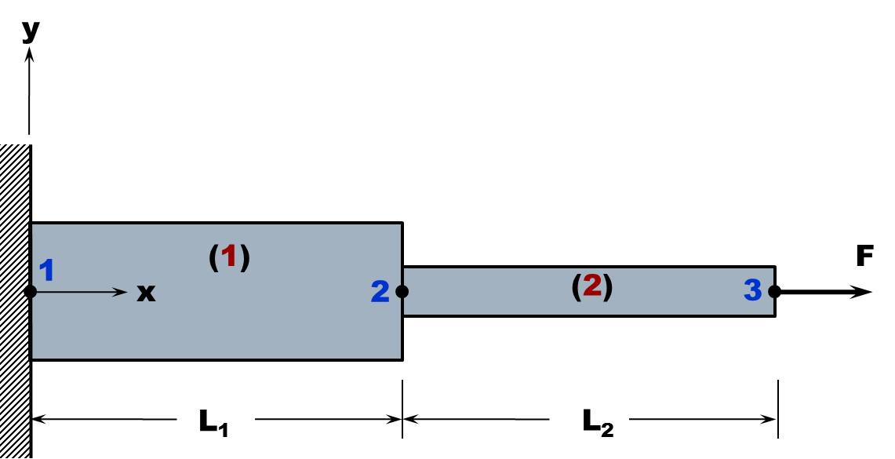
The Structure is Discretized.
F₁
F₂
F₃
1
(1)
2
(2)
3
L₁
L₂
1
(1)
2
2
(2)
3

Slide 4
Assembling the Stiffness Matrix for the Entire Structure
17
L₁
L₂
x
1
(1)
2
2
(2)
3
18
19
Notes:
Work Potential is opposite in sign to the work performed on the system

Slide 5
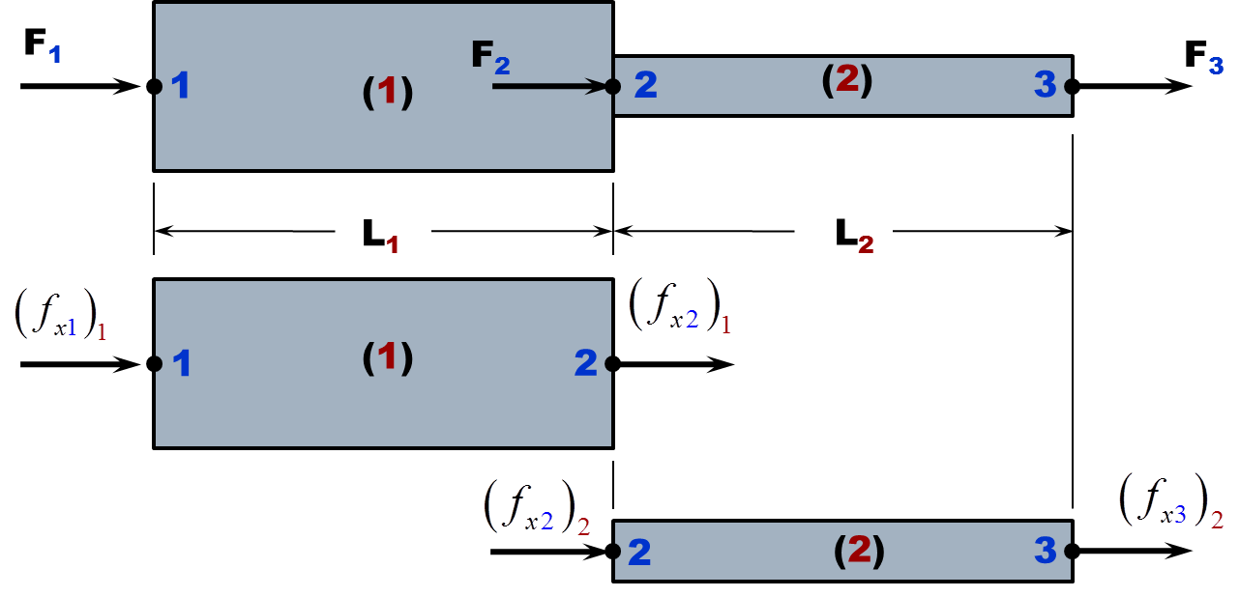
Totaling Forces at Leads to System Stiffness Matrix
18
19
20
Notes:
Nodal Force Vector
Stiffness Matrix
Displacement Vector
Note how 18 and 19 overlap in 20

Slide 6
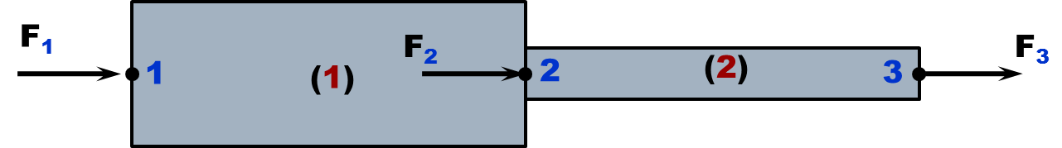
Totaling Forces at Leads to System Stiffness Matrix
20
Net Applied Forces at Nodes
Notes:
Nodal Force Vector
Stiffness Matrix
Displacement Vector
Note how 18 and 19 overlap in 20

Slide 7
Partition Out Force Equations Where Displacements Known
0
21
22
Notes:
Nodal Force Vector
Stiffness Matrix
Displacement Vector
Note how 18 and 19 overlap in 20

Slide 8
Reduced Stiffness Matrix Inverted to Solve for Unknowns
22
0
21
25
0
23
F
24
Notes:
Nodal Force Vector
Stiffness Matrix
Displacement Vector
Note how 18 and 19 overlap in 20

Slide 9
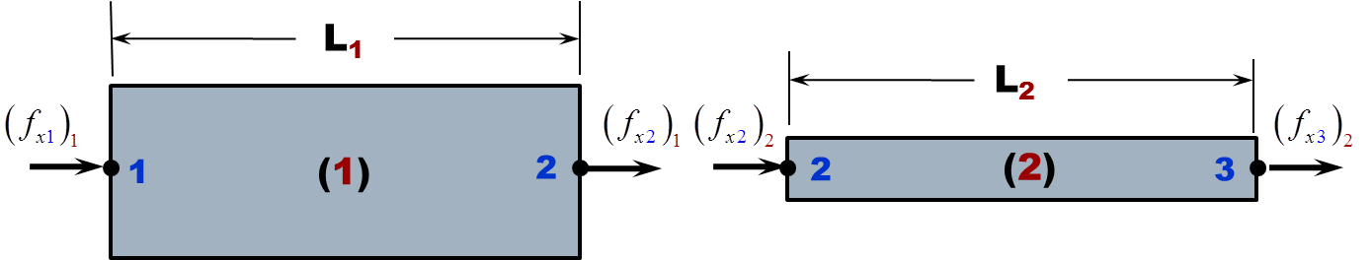
Nodal Forces Determined From Displacement Results
Starting with Element 1, using
18
18
From the BC u₁=0 and from u₂
23
26
Now for Element 2, using
19
19
From and
23
24
27
Notes:
Nodal Force Vector
Stiffness Matrix
Displacement Vector
Note how 18 and 19 overlap in 20

Slide 10
Stress Determined From Displacement Calculations
Starting with Element 1, using
6
From the BC u₁=0 and from u₂
23
Now for Element 2, using
6
From and
23
24
Notes:
Nodal Force Vector
Stiffness Matrix
Displacement Vector
Note how 18 and 19 overlap in 20

Slide 11
A Two-Element Axial Structure Used to Demonstrate Assembly
y
E=50GPa
A₁=100mm²
A₂=75mm²
(1)
A₃=50mm²
1
2
(2)
20kn
x
x
(3)
4
3
200mm
150mm
125mm

Slide 12
Example 2 Determine the Nodal Forces
k₂=30 lb/in
1
2
3
F=40 lb
k₁=50 lb/in
4
k₃=70 lb/in

Slide 13
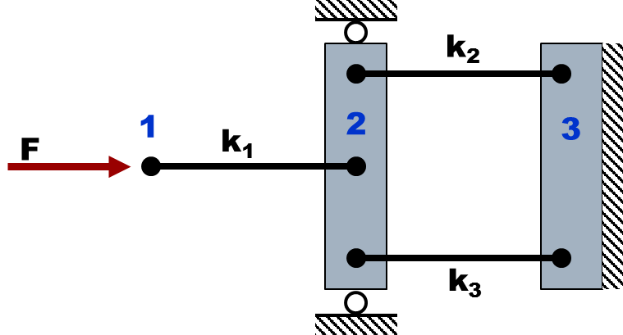
Example 2
2
(2)
3
1
(1)
2
(3)
2
3

Slide 14
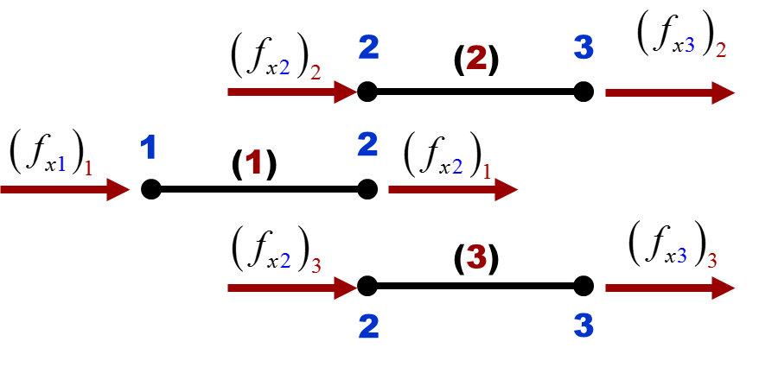
Example 2

Slide 15
Homework
k₂=35 lb/in
F=80 lb
k₁=35 lb/in
k₃=25 lb/in
k₄=30 lb/in
Determine the nodal forces and displacements.

